Slide 1
Sorting

Slide 2
Introduction
Sorting is the process of ordering a list of objects, according to some linear order, such as
a₁ ≤ a₂ ≤ a₃ ≤ a₄ ≤ a₅ ≤ a₆
Sorting can be divided into two parts i.e.
  Internal, and
  external.
Internal sorting
  When all the data is stored in the main memory
  The random access nature of the memory can be utilized
External sorting
  When the size of data too large
  The main memory cannot accommodate all the data
  Virtual memory (swapping the data in/out of the memory) is thus used

Slide 3
Introduction
External sorting
  The bottleneck is usually the data movement between the secondary storage and the main memory.
  Data movement is efficient if it is moved in the form of large blocks.
  However, moving large blocks of data is efficient only if it is physically located in contiguous locations.

Slide 4
Introduction
The simplest algorithms usually take O(n²) time to sort n objects, and suited for sorting short lists.
One of the most popular algorithms is Quick-Sort takes O(nlogn) time on average.
Quick-Sort works for most common applications, although in worst case it can take O(n²) time.

Slide 5
Introduction
There are other sorting techniques, such as Merge-Sort and Heap-Sort that take time O(nlogn) in worst case.
Merge-Sort however, is well suited for external sorting.
There are other algorithms such as “bucket” and “radix” sort when the keys are integers of known range. They take time O(n).

Slide 6
Introduction
The sorting problem is to arrange a sequence of records so that the values of their key fields form a non-decreasing sequence.
Given records r₁, r₁, …. r_{n} with key values k₁, k₁, …. k_{n}, respectively we must produce the same records in an order ri₁, ri₂, …. ri_{n} such that the keys are in the corresponding non-decreasing order.
  key(ri₁) ≤ key(ri₂) ≤ key(ri₃) ≤ key(ri₄) ≤ key(ri₅) ≤ key(ri₆)
  → ki₁ ≤ ki₂ ≤ ki₃ ≤ ki₄ ≤ ki₅ ≤ ki₆
The records may NOT have distinct values, and can appear in any order.
Different criteria to evaluate the running time, as follows:
  Number of algorithm steps.
  Number of comparisons between the keys (for expensive comparisons).
  The number of times a record is moved (for large records).

Slide 7
Bubble Sort
One of the simplest sorting methods.
The basic idea is the “weight” of the record.
The records are kept in an array held vertically.
“light” records bubbling up to the top.
We make repeated passes over the array from bottom to top.
If two adjacent elements are out of order i.e. “lighter” one is below, we reverse the order.

Slide 8
Bubble Sort
The overall effect, is that after the first pass the “lightest” record will bubble all the way to the top.
On the second top pass, the second lowest rises to the second position, and so on.
On second pass we need not try bubbling to the top position, because we know that the lightest record is already there.

Slide 9
Bubble Sort
int n =N; // N is the size of the array;
for (int i = 0; i < N; i++){
for (int j = 1; j < n; j++) {
if (A[j] < A[j-1]) {
swap(j-1 , j);
}//end if
} //end inner for
} //end inner for
Complexity ?
O(N²)
➔
Algorithm does not exit
until all the data is checked
// Swap function assumes that
// A[n] is a globally declared array
swap ( x , y) {
int temp = A[ x ];
A[ x ] = A[ y ];
A[ y ] = temp;
}

Slide 10
Bubble Sort
int n =N; // N is the size of the array;
for (int i = 0; i < N; i++){
int swapped = 0;
for (int j = 1; j < n; j++) {
if (A[j] < A[j-1]) {
swap(j-1 , j);
swapped = 1;
}//end if
} //end inner for
// n = n-1;
if (swapped == 0)
break;
} //end inner for
Complexity ?
O(N²)
// Swap function assumes that
// A[n] is a globally declared array
swap ( x , y) {
int temp = A[ x ];
A[ x ] = A[ y ];
A[ y ] = temp;
}
➔
Algorithm exits if no swap done
in previous (outer loop) step

Slide 11
Bubble Sort
int n =N; // N is the size of the array;
for (int i = 0; i < N; i++){
int swapped = 0;
for (int j = 1; j < n; j++) {
if (A[j] < A[j-1]) {
swap(j-1 , j);
swapped = 1;
}//end if
} //end inner for
n = n-1;
if (swapped == 0)
break;
} //end inner for
Complexity ?
O(N²)
// Swap function assumes that
// A[n] is a globally declared array
swap ( x , y) {
int temp = A[ x ];
A[ x ] = A[ y ];
A[ y ] = temp;
}
No bubbling to the top position, because the lightest record is already there.
➔
Algorithm exits if no swap done
in previous (outer loop) step

Slide 12
Bubble Sort Example (First Pass)
i = 0
62 ⁽⁰⁾ | 58 ⁽¹⁾ | 55 ⁽²⁾ | 10 ⁽³⁾ | 45 ⁽⁴⁾ | 44 ⁽⁵⁾ | 6 ⁽⁶⁾ | 90 ⁽⁷⁾
j = 1
58 ⁽⁰⁾ | 62 ⁽¹⁾ | 55 ⁽²⁾ | 10 ⁽³⁾ | 45 ⁽⁴⁾ | 44 ⁽⁵⁾ | 6 ⁽⁶⁾ | 90 ⁽⁷⁾
swap(A[0] , A[1])
j = 2
58 ⁽⁰⁾ | 55 ⁽¹⁾ | 62 ⁽²⁾ | 10 ⁽³⁾ | 45 ⁽⁴⁾ | 44 ⁽⁵⁾ | 6 ⁽⁶⁾ | 90 ⁽⁷⁾
swap(A[1] , A[2])
j = 3
58 ⁽⁰⁾ | 55 ⁽¹⁾ | 10 ⁽²⁾ | 62 ⁽³⁾ | 45 ⁽⁴⁾ | 44 ⁽⁵⁾ | 6 ⁽⁶⁾ | 90 ⁽⁷⁾
swap(A[2] , A[3])
j = 4
58 ⁽⁰⁾ | 55 ⁽¹⁾ | 10 ⁽²⁾ | 45 ⁽³⁾ | 62 ⁽⁴⁾ | 44 ⁽⁵⁾ | 6 ⁽⁶⁾ | 90 ⁽⁷⁾
swap(A[3] , A[4])
j = 5
58 ⁽⁰⁾ | 55 ⁽¹⁾ | 10 ⁽²⁾ | 45 ⁽³⁾ | 44 ⁽⁴⁾ | 62 ⁽⁵⁾ | 6 ⁽⁶⁾ | 90 ⁽⁷⁾
swap(A[4] , A[5])
j = 6
58 ⁽⁰⁾ | 55 ⁽¹⁾ | 10 ⁽²⁾ | 45 ⁽³⁾ | 44 ⁽⁴⁾ | 6 ⁽⁵⁾ | 62 ⁽⁶⁾ | 90 ⁽⁷⁾
swap(A[5] , A[6])
j = 7
58 ⁽⁰⁾ | 55 ⁽¹⁾ | 10 ⁽²⁾ | 45 ⁽³⁾ | 44 ⁽⁴⁾ | 6 ⁽⁵⁾ | 62 ⁽⁶⁾ | 90 ⁽⁷⁾
int n =N; // N is the size of the array;
for (int i = 0; i < N; i++){
int swapped = 0;
for (int j = 1; j < n; j++)
if (A[j] < A[j-1]) {
swap(j-1 , j); swapped = 1;
}//end if
n = n-1;
if (swapped == 0)
break; }//End outer for

Slide 13
Bubble Sort Example (Second Pass)
i = 1
58 ⁽⁰⁾ | 55 ⁽¹⁾ | 10 ⁽²⁾ | 45 ⁽³⁾ | 44 ⁽⁴⁾ | 6 ⁽⁵⁾ | 62 ⁽⁶⁾ | 90 ⁽⁷⁾
swap(A[0] , A[1])
j = 1
55 ⁽⁰⁾ | 58 ⁽¹⁾ | 10 ⁽²⁾ | 45 ⁽³⁾ | 44 ⁽⁴⁾ | 6 ⁽⁵⁾ | 62 ⁽⁶⁾ | 90 ⁽⁷⁾
swap(A[1] , A[2])
j = 2
55 ⁽⁰⁾ | 10 ⁽¹⁾ | 58 ⁽²⁾ | 45 ⁽³⁾ | 44 ⁽⁴⁾ | 6 ⁽⁵⁾ | 62 ⁽⁶⁾ | 90 ⁽⁷⁾
j = 3
55 ⁽⁰⁾ | 10 ⁽¹⁾ | 45 ⁽²⁾ | 58 ⁽³⁾ | 44 ⁽⁴⁾ | 6 ⁽⁵⁾ | 62 ⁽⁶⁾ | 90 ⁽⁷⁾
swap(A[2] , A[3])
j = 4
swap(A[3] , A[4])
55 ⁽⁰⁾ | 10 ⁽¹⁾ | 45 ⁽²⁾ | 44 ⁽³⁾ | 58 ⁽⁴⁾ | 6 ⁽⁵⁾ | 62 ⁽⁶⁾ | 90 ⁽⁷⁾
swap(A[4] , A[5])
j = 5
55 ⁽⁰⁾ | 10 ⁽¹⁾ | 45 ⁽²⁾ | 44 ⁽³⁾ | 6 ⁽⁴⁾ | 58 ⁽⁵⁾ | 62 ⁽⁶⁾ | 90 ⁽⁷⁾
j = 6
55 ⁽⁰⁾ | 10 ⁽¹⁾ | 45 ⁽²⁾ | 44 ⁽³⁾ | 6 ⁽⁴⁾ | 58 ⁽⁵⁾ | 62 ⁽⁶⁾ | 90 ⁽⁷⁾
int n =N; // N is the size of the array;
for (int i = 0; i < N; i++){
int swapped = 0;
for (int j = 1; j < n; j++)
if (A[j] < A[j-1]) {
swap(j-1 , j); swapped = 1;
}//end if
n = n-1;
if (swapped == 0)
break; }//End outer for

Slide 14
Bubble Sort Example (Third Pass)
i = 2
55 ⁽⁰⁾ | 10 ⁽¹⁾ | 45 ⁽²⁾ | 44 ⁽³⁾ | 6 ⁽⁴⁾ | 58 ⁽⁵⁾ | 62 ⁽⁶⁾ | 90 ⁽⁷⁾
j = 1
j = 2
j = 3
j = 4
j = 5
10 ⁽⁰⁾ | 45 ⁽¹⁾ | 44 ⁽²⁾ | 6 ⁽³⁾ | 55 ⁽⁴⁾ | 58 ⁽⁵⁾ | 62 ⁽⁶⁾ | 90 ⁽⁷⁾
int n =N; // N is the size of the array;
for (int i = 0; i < N; i++){
int swapped = 0;
for (int j = 1; j < n; j++)
if (A[j] < A[j-1]) {
swap(j-1 , j); swapped = 1;
}//end if
n = n-1;
if (swapped == 0)
break; }//End outer for

Slide 15
Bubble Sort Example (Fourth Pass)
i = 3
10 ⁽⁰⁾ | 45 ⁽¹⁾ | 44 ⁽²⁾ | 6 ⁽³⁾ | 55 ⁽⁴⁾ | 58 ⁽⁵⁾ | 62 ⁽⁶⁾ | 90 ⁽⁷⁾
j = 1
j = 2
j = 3
j = 4
10 ⁽⁰⁾ | 44 ⁽¹⁾ | 6 ⁽²⁾ | 45 ⁽³⁾ | 55 ⁽⁴⁾ | 58 ⁽⁵⁾ | 62 ⁽⁶⁾ | 90 ⁽⁷⁾
int n =N; // N is the size of the array;
for (int i = 0; i < N; i++){
int swapped = 0;
for (int j = 1; j < n; j++)
if (A[j] < A[j-1]) {
swap(j-1 , j); swapped = 1;
}//end if
n = n-1;
if (swapped == 0)
break; }//End outer for

Slide 16
Bubble Sort Example (Fifth Pass)
i = 4
10 ⁽⁰⁾ | 44 ⁽¹⁾ | 6 ⁽²⁾ | 45 ⁽³⁾ | 55 ⁽⁴⁾ | 58 ⁽⁵⁾ | 62 ⁽⁶⁾ | 90 ⁽⁷⁾
j = 1
j = 2
j = 3
10 ⁽⁰⁾ | 6 ⁽¹⁾ | 44 ⁽²⁾ | 45 ⁽³⁾ | 55 ⁽⁴⁾ | 58 ⁽⁵⁾ | 62 ⁽⁶⁾ | 90 ⁽⁷⁾
int n =N; // N is the size of the array;
for (int i = 0; i < N; i++){
int swapped = 0;
for (int j = 1; j < n; j++)
if (A[j] < A[j-1]) {
swap(j-1 , j); swapped = 1;
}//end if
n = n-1;
if (swapped == 0)
break; }//End outer for

Slide 17
Bubble Sort Example (Sixth Pass)
i = 5
10 ⁽⁰⁾ | 6 ⁽¹⁾ | 44 ⁽²⁾ | 45 ⁽³⁾ | 55 ⁽⁴⁾ | 58 ⁽⁵⁾ | 62 ⁽⁶⁾ | 90 ⁽⁷⁾
j = 1
j = 2
6 ⁽⁰⁾ | 10 ⁽¹⁾ | 44 ⁽²⁾ | 45 ⁽³⁾ | 55 ⁽⁴⁾ | 58 ⁽⁵⁾ | 62 ⁽⁶⁾ | 90 ⁽⁷⁾
int n =N; // N is the size of the array;
for (int i = 0; i < N; i++){
int swapped = 0;
for (int j = 1; j < n; j++)
if (A[j] < A[j-1]) {
swap(j-1 , j); swapped = 1;
}//end if
n = n-1;
if (swapped == 0)
break; }//End outer for

Slide 18
Bubble Sort Example (Seventh Pass)
i = 6
6 ⁽⁰⁾ | 10 ⁽¹⁾ | 44 ⁽²⁾ | 45 ⁽³⁾ | 55 ⁽⁴⁾ | 58 ⁽⁵⁾ | 62 ⁽⁶⁾ | 90 ⁽⁷⁾
j = 1
6 ⁽⁰⁾ | 10 ⁽¹⁾ | 44 ⁽²⁾ | 45 ⁽³⁾ | 55 ⁽⁴⁾ | 58 ⁽⁵⁾ | 62 ⁽⁶⁾ | 90 ⁽⁷⁾
int n =N; // N is the size of the array;
for (int i = 0; i < N; i++){
int swapped = 0;
for (int j = 1; j < n; j++)
if (A[j] < A[j-1]) {
swap(j-1 , j); swapped = 1;
}//end if
n = n-1;
if (swapped == 0)
break; }//End outer for

Slide 19
Bubble Sort
int n =N; // N is the size of the array;
for (int i = 0; i < N; i++){
for (int j = 1; j < n; j++) {
if (A[j] < A[j-1]) {
swap(j-1 , j);
}//end if
} //end inner for
} //end inner for
Complexity ?
O(N²)
➔
Algorithm does not exit
until all the data is checked

Slide 20
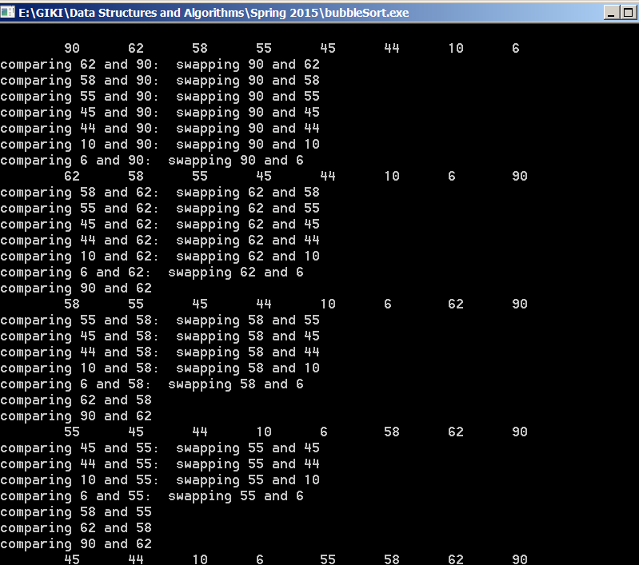
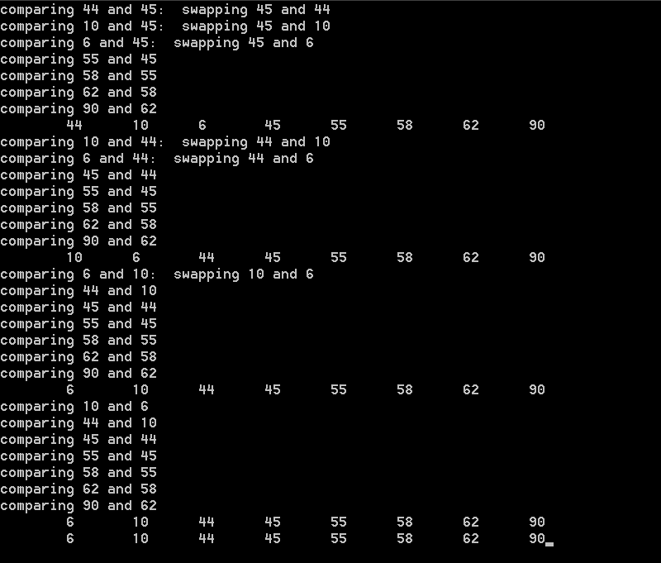
Bubble Sort – output(1) worst case

Slide 21
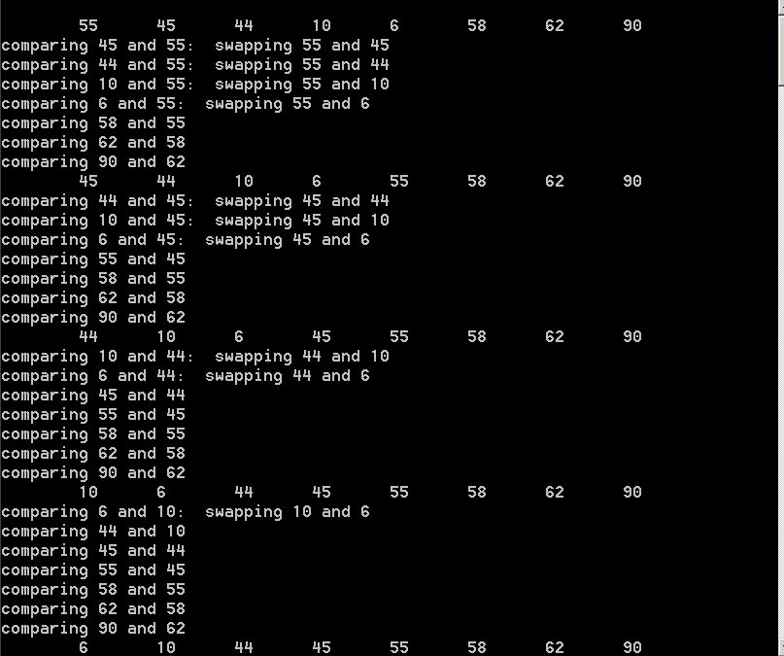
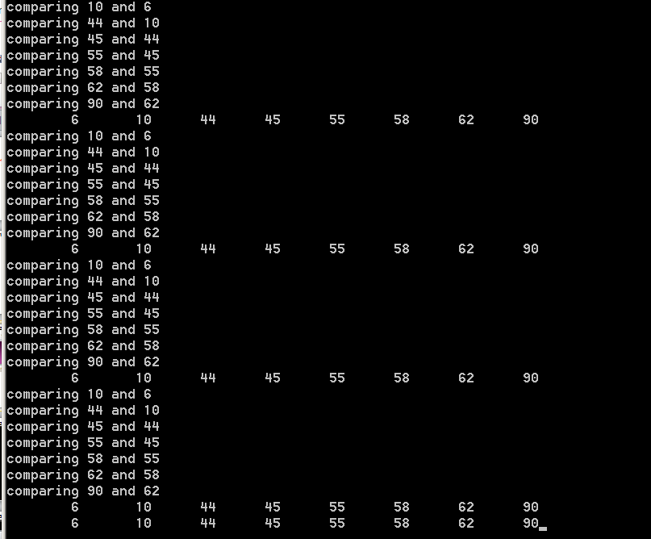
Bubble Sort – output(2) mixed data

Slide 22
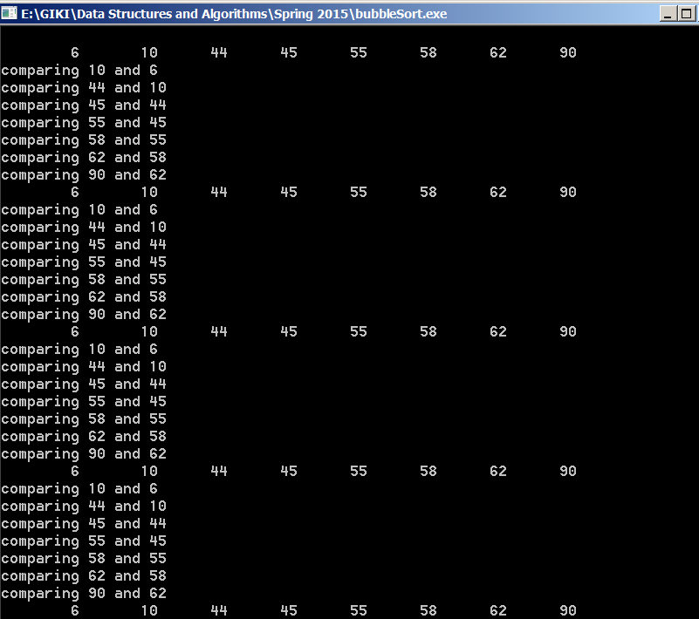
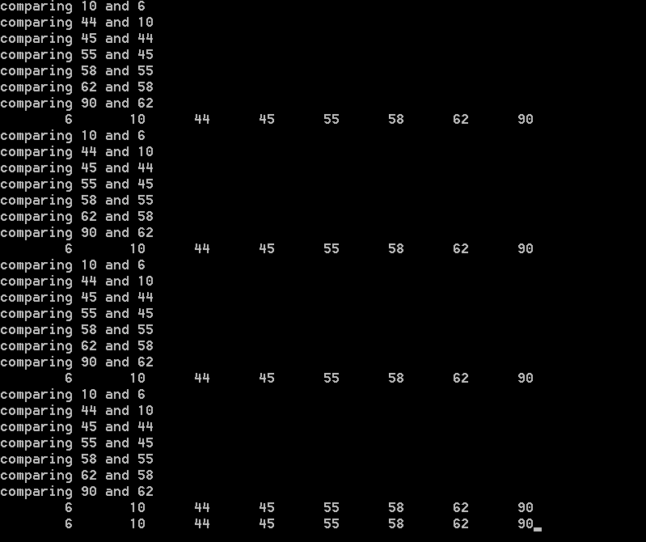
Bubble Sort – output(1) Best case

Slide 23
Bubble Sort
int n =N; // N is the size of the array;
for (int i = 0; i < N; i++){
int swapped = 0;
for (int j = 1; j < n; j++) {
if (A[j] < A[j-1]) {
swap(j-1 , j);
swapped = 1;
}//end if
} //end inner for
n = n-1;
if (swapped == 0)
break;
} //end inner for
Complexity ?
O(N²)
➔
Algorithm exits if no swap done
in previous (outer loop) step

Slide 24
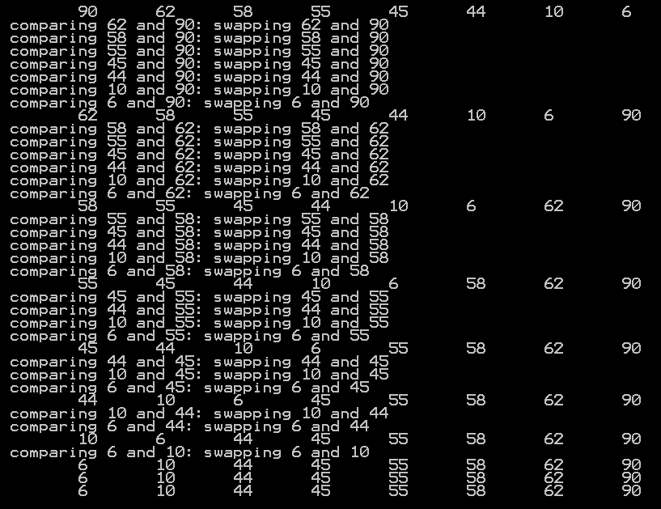
Bubble Sort – output(1) worst case

Slide 25
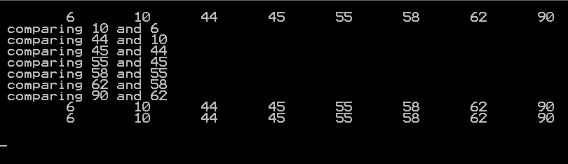
Bubble Sort – output (1) best case

Slide 26
Insertion Sort
On the ith pass we “insert” the ith element A[i] into its rightful place among A[1],A[2],…A[i-1] which were placed in sorted order.
After this insertion A[1],A[2],…A[i] are in sorted order.

Slide 27
Insertion Sort
for (int i =1, i < n, i++){
temp = A[i];
for (int j = i, j>0 && A[j-1] > temp, j--)
A[j] = A[j-1]
A[j] = temp;
}// end outer for
Complexity ?
O(N²)

Slide 28
Insertion Sort Example (First Pass)
i = 1
62 ⁽⁰⁾ | 58 ⁽¹⁾ | 55 ⁽²⁾ | 10 ⁽³⁾ | 45 ⁽⁴⁾ | 44 ⁽⁵⁾ | 6 ⁽⁶⁾ | 90 ⁽⁷⁾
temp = 58
j = 1
62 ⁽⁰⁾ | 62 ⁽¹⁾ | 55 ⁽²⁾ | 10 ⁽³⁾ | 45 ⁽⁴⁾ | 44 ⁽⁵⁾ | 6 ⁽⁶⁾ | 90 ⁽⁷⁾
A[1] = A[0]
j = 0
62 > 58
58 ⁽⁰⁾ | 62 ⁽¹⁾ | 55 ⁽²⁾ | 10 ⁽³⁾ | 45 ⁽⁴⁾ | 44 ⁽⁵⁾ | 6 ⁽⁶⁾ | 90 ⁽⁷⁾
→ j > 0 && A [j -1] > temp
➔ A[1] = A[0]
A[0] = temp
= 58;
→ j = 0
➔ exit
A[j] = temp (= 58)
for (int i =1, i < n, i++){
temp = A[i];
for (int j = i, j > 0 && A[j-1] > temp, j--)
A[j] = A[j-1]
A[j] = temp;
}// end outer for

Slide 29
Insertion Sort Example (Second Pass)
i = 2
58 ⁽⁰⁾ | 62 ⁽¹⁾ | 55 ⁽²⁾ | 10 ⁽³⁾ | 45 ⁽⁴⁾ | 44 ⁽⁵⁾ | 6 ⁽⁶⁾ | 90 ⁽⁷⁾
temp = 55
62 > 55
j = 2
58 ⁽⁰⁾ | 62 ⁽¹⁾ | 62 ⁽²⁾ | 10 ⁽³⁾ | 45 ⁽⁴⁾ | 44 ⁽⁵⁾ | 6 ⁽⁶⁾ | 90 ⁽⁷⁾
A[2] = A[1]
58 > 55
j = 1
58 ⁽⁰⁾ | 58 ⁽¹⁾ | 62 ⁽²⁾ | 10 ⁽³⁾ | 45 ⁽⁴⁾ | 44 ⁽⁵⁾ | 6 ⁽⁶⁾ | 90 ⁽⁷⁾
A[1] = A[0]
j = 0
55 ⁽⁰⁾ | 58 ⁽¹⁾ | 62 ⁽²⁾ | 10 ⁽³⁾ | 45 ⁽⁴⁾ | 44 ⁽⁵⁾ | 6 ⁽⁶⁾ | 90 ⁽⁷⁾
A[0] = temp
= 55;
for (int i =1, i < n, i++){
temp = A[i];
for (int j = i, j > 0 && A[j-1] > temp, j--)
A[j] = A[j-1]
A[j] = temp;
}// end outer for

Slide 30
Insertion Sort Example (Third Pass)
i = 3
55 ⁽⁰⁾ | 58 ⁽¹⁾ | 62 ⁽²⁾ | 10 ⁽³⁾ | 45 ⁽⁴⁾ | 44 ⁽⁵⁾ | 6 ⁽⁶⁾ | 90 ⁽⁷⁾
temp = 10
j = 3
55 ⁽⁰⁾ | 58 ⁽¹⁾ | 62 ⁽²⁾ | 62 ⁽³⁾ | 45 ⁽⁴⁾ | 44 ⁽⁵⁾ | 6 ⁽⁶⁾ | 90 ⁽⁷⁾
A[3] = A[2]
j = 2
55 ⁽⁰⁾ | 58 ⁽¹⁾ | 58 ⁽²⁾ | 62 ⁽³⁾ | 45 ⁽⁴⁾ | 44 ⁽⁵⁾ | 6 ⁽⁶⁾ | 90 ⁽⁷⁾
A[2] = A[1]
j = 1
55 ⁽⁰⁾ | 55 ⁽¹⁾ | 58 ⁽²⁾ | 62 ⁽³⁾ | 45 ⁽⁴⁾ | 44 ⁽⁵⁾ | 6 ⁽⁶⁾ | 90 ⁽⁷⁾
A[1] = A[0]
j = 0
10 ⁽⁰⁾ | 55 ⁽¹⁾ | 58 ⁽²⁾ | 62 ⁽³⁾ | 45 ⁽⁴⁾ | 44 ⁽⁵⁾ | 6 ⁽⁶⁾ | 90 ⁽⁷⁾
A[0] = temp
= 55;
for (int i =1, i < n, i++){
temp = A[i];
for (int j = i, j > 0 && A[j-1] > temp, j--)
A[j] = A[j-1]
A[j] = temp;
}// end outer for

Slide 31
Insertion Sort Example (Fourth Pass)
i = 4
10 ⁽⁰⁾ | 55 ⁽¹⁾ | 58 ⁽²⁾ | 62 ⁽³⁾ | 45 ⁽⁴⁾ | 44 ⁽⁵⁾ | 6 ⁽⁶⁾ | 90 ⁽⁷⁾
temp = 45
j = 4
10 ⁽⁰⁾ | 55 ⁽¹⁾ | 58 ⁽²⁾ | 62 ⁽³⁾ | 62 ⁽⁴⁾ | 44 ⁽⁵⁾ | 6 ⁽⁶⁾ | 90 ⁽⁷⁾
A[4] = A[3]
j = 3
10 ⁽⁰⁾ | 55 ⁽¹⁾ | 58 ⁽²⁾ | 58 ⁽³⁾ | 62 ⁽⁴⁾ | 44 ⁽⁵⁾ | 6 ⁽⁶⁾ | 90 ⁽⁷⁾
A[3] = A[2]
j = 2
10 ⁽⁰⁾ | 55 ⁽¹⁾ | 55 ⁽²⁾ | 58 ⁽³⁾ | 62 ⁽⁴⁾ | 44 ⁽⁵⁾ | 6 ⁽⁶⁾ | 90 ⁽⁷⁾
A[2] = A[1]
10 > 45
j = 1
10 ⁽⁰⁾ | 45 ⁽¹⁾ | 55 ⁽²⁾ | 58 ⁽³⁾ | 62 ⁽⁴⁾ | 44 ⁽⁵⁾ | 6 ⁽⁶⁾ | 90 ⁽⁷⁾
A[1] = temp
= 45;
for (int i =1, i < n, i++){
temp = A[i];
for (int j = i, j > 0 && A[j-1] > temp , j--)
A[j] = A[j-1]
A[j] = temp;
}// end outer for

Slide 32
Insertion Sort Example (Fifth Pass)
i = 5
10 ⁽⁰⁾ | 45 ⁽¹⁾ | 55 ⁽²⁾ | 58 ⁽³⁾ | 62 ⁽⁴⁾ | 44 ⁽⁵⁾ | 6 ⁽⁶⁾ | 90 ⁽⁷⁾
temp = 44
j = 5
10 ⁽⁰⁾ | 45 ⁽¹⁾ | 55 ⁽²⁾ | 58 ⁽³⁾ | 62 ⁽⁴⁾ | 62 ⁽⁵⁾ | 6 ⁽⁶⁾ | 90 ⁽⁷⁾
A[5] = A[4]
j = 4
10 ⁽⁰⁾ | 45 ⁽¹⁾ | 55 ⁽²⁾ | 58 ⁽³⁾ | 58 ⁽⁴⁾ | 62 ⁽⁵⁾ | 6 ⁽⁶⁾ | 90 ⁽⁷⁾
A[4] = A[3]
j = 3
10 ⁽⁰⁾ | 45 ⁽¹⁾ | 55 ⁽²⁾ | 55 ⁽³⁾ | 58 ⁽⁴⁾ | 62 ⁽⁵⁾ | 6 ⁽⁶⁾ | 90 ⁽⁷⁾
A[3] = A[2]
j = 2
10 ⁽⁰⁾ | 45 ⁽¹⁾ | 45 ⁽²⁾ | 55 ⁽³⁾ | 58 ⁽⁴⁾ | 62 ⁽⁵⁾ | 6 ⁽⁶⁾ | 90 ⁽⁷⁾
A[2] = A[1]
j = 1
10 ⁽⁰⁾ | 44 ⁽¹⁾ | 45 ⁽²⁾ | 55 ⁽³⁾ | 58 ⁽⁴⁾ | 62 ⁽⁵⁾ | 6 ⁽⁶⁾ | 90 ⁽⁷⁾
A[1] = temp
= 44;
for (int i =1, i < n, i++){
temp = A[i];
for (int j = i, j > 0 && A[j-1] > temp, j--)
A[j] = A[j-1]
A[j] = temp;
}// end outer for

Slide 33
Insertion Sort Example (Sixth Pass)
i = 6
10 ⁽⁰⁾ | 44 ⁽¹⁾ | 45 ⁽²⁾ | 55 ⁽³⁾ | 58 ⁽⁴⁾ | 62 ⁽⁵⁾ | 6 ⁽⁶⁾ | 90 ⁽⁷⁾
temp = 6
j = 6
10 ⁽⁰⁾ | 44 ⁽¹⁾ | 45 ⁽²⁾ | 55 ⁽³⁾ | 58 ⁽⁴⁾ | 62 ⁽⁵⁾ | 62⁽⁶⁾ | 90 ⁽⁷⁾
A[6] = A[5]
j = 5
10 ⁽⁰⁾ | 44 ⁽¹⁾ | 45 ⁽²⁾ | 55 ⁽³⁾ | 58 ⁽⁴⁾ | 58 ⁽⁵⁾ | 62⁽⁶⁾ | 90 ⁽⁷⁾
A[5] = A[4]
j = 4
10 ⁽⁰⁾ | 44 ⁽¹⁾ | 45 ⁽²⁾ | 55 ⁽³⁾ | 55 ⁽⁴⁾ | 58 ⁽⁵⁾ | 62⁽⁶⁾ | 90 ⁽⁷⁾
A[4] = A[3]
j = 3
10 ⁽⁰⁾ | 44 ⁽¹⁾ | 45 ⁽²⁾ | 45 ⁽³⁾ | 55 ⁽⁴⁾ | 58 ⁽⁵⁾ | 62⁽⁶⁾ | 90 ⁽⁷⁾
A[3] = A[2]
j = 2
10 ⁽⁰⁾ | 44 ⁽¹⁾ | 45 ⁽²⁾ | 45 ⁽³⁾ | 55 ⁽⁴⁾ | 58 ⁽⁵⁾ | 62⁽⁶⁾ | 90 ⁽⁷⁾
A[2] = A[1]
j = 1
10 ⁽⁰⁾ | 10 ⁽¹⁾ | 45 ⁽²⁾ | 45 ⁽³⁾ | 55 ⁽⁴⁾ | 58 ⁽⁵⁾ | 62⁽⁶⁾ | 90 ⁽⁷⁾
A[1] = A[0]
j = 0
6 ⁽⁰⁾ | 10 ⁽¹⁾ | 45 ⁽²⁾ | 45 ⁽³⁾ | 55 ⁽⁴⁾ | 58 ⁽⁵⁾ | 62⁽⁶⁾ | 90 ⁽⁷⁾
A[0] = temp
= 6;
for (int i =1, i < n, i++){
temp = A[i];
for (int j = i, j > 0 && A[j-1] > temp, j--)
A[j] = A[j-1]
A[j] = temp;
}// end outer for

Slide 34
Insertion Sort Example (Sixth Pass)
i = 7
6 ⁽⁰⁾ | 10 ⁽¹⁾ | 45 ⁽²⁾ | 45 ⁽³⁾ | 55 ⁽⁴⁾ | 58 ⁽⁵⁾ | 62⁽⁶⁾ | 90 ⁽⁷⁾
temp = 90
A[j-1] > temp?
No
Quit
for (int i =1, i < n, i++){
temp = A[i];
for (int j = i, j > 0 && A[j-1] > temp, j--)
A[j] = A[j-1]
A[j] = temp;
}// end outer for

Slide 35
Insertion Sort Example (Sixth Pass)
i = 7
6 ⁽⁰⁾ | 10 ⁽¹⁾ | 45 ⁽²⁾ | 45 ⁽³⁾ | 55 ⁽⁴⁾ | 58 ⁽⁵⁾ | 62⁽⁶⁾ | 90 ⁽⁷⁾
temp = 90
A[j-1] > temp?
No
Quit
for (int i =1, i < n, i++){
temp = A[i];
for (int j = i, j > 0 && A[j-1] > temp, j--)
A[j] = A[j-1]
A[j] = temp;
}// end outer for

Slide 36
Analysis of Insertion Sort
Because of the nested loops, each of which can take n iterations, insertion sort is O(n²).
Furthermore, this bound is tight, because input in reverse order can actually achieve this bound.
A precise calculation shows that the test at line 3 can be executed at most i times for each value of i. Summing over all i gives a total of
If the input is presorted, the running time is O(n)
  because the test in the inner for loop always fails immediately
The average running time also O(n²)

Slide 37
Selection Sort
Find the minimum value in the list
Swap it with the value in the first position
Repeat the steps above for the remainder of the list (starting at the second position and advancing each time)
http://en.wikipedia.org/wiki/Selection_sort

Slide 38
Selection Sort
for (int i =0, i < n, i++){
min = i;
for (int j = i+1, j < n , j++){
if ( A[j] < A[min]){
min = j
} // end if
}// end inner for
swap(i, min)
}// end outer for
Complexity ?
O(N²)
// Swap function assumes that
// A[n] is a globally declared array
swap(i, min) {
int temp = A[i];
A[i] = A[min];
A[min] = temp;
}

Slide 39
Selection Sort - Example
The Selection Sort might swap an array element with itself--this is harmless.
7
2
8
5
4
2
7
8
5
4
for (int i =0, i < n, i++){
min = i;
for (int j = i+1, j < n , j++){
if ( A[j] < A[min]){
min = j
} // end if
}// end inner for
swap(i, min)
}// end outer for
2
4
8
5
7
2
4
5
8
7
2
4
5
7
8

Slide 40
Selection Sort Example
min = 6
i = 0
62 ⁽⁰⁾ | 58 ⁽¹⁾ | 55 ⁽²⁾ | 10 ⁽³⁾ | 45 ⁽⁴⁾ | 44 ⁽⁵⁾ | 6 ⁽⁶⁾ | 90 ⁽⁷⁾
A[min] = 6
A[min] = 62
A[min] = 58
A[min] = 55
A[min] = 10
A[min] = 10
A[min] = 10
A[min] = 6
A[min] = 6
min = 3
i = 1
6 ⁽⁰⁾ | 58 ⁽¹⁾ | 55 ⁽²⁾ | 10 ⁽³⁾ | 45 ⁽⁴⁾ | 44 ⁽⁵⁾ | 62 ⁽⁶⁾ | 90 ⁽⁷⁾
A[min] = 10
A[min] = 58
A[min] = 55
A[min] = 10
A[min] = 10
A[min] = 10
A[min] = 10
A[min] = 10
min = 5
i = 2
6 ⁽⁰⁾ | 10 ⁽¹⁾ | 55 ⁽²⁾ | 58 ⁽³⁾ | 45 ⁽⁴⁾ | 44 ⁽⁵⁾ | 62 ⁽⁶⁾ | 90 ⁽⁷⁾
A[min] = 44
A[min] = 55
A[min] = 58
A[min] = 45
A[min] = 44
A[min] = 44
A[min] = 44
i = 3
6 ⁽⁰⁾ | 10 ⁽¹⁾ | 44 ⁽²⁾ | 58 ⁽³⁾ | 45 ⁽⁴⁾ | 55 ⁽⁵⁾ | 62 ⁽⁶⁾ | 90 ⁽⁷⁾
min = 4
A[min] = 45
A[min] = 58
A[min] = 45
A[min] = 45
A[min] = 45
A[min] = 45
for (int i =0, i < n, i++){
min = i;
for (int j = i+1, j < n , j++){
if ( A[j] < A[min]){
min = j
} // end if
}// end inner for
swap(i, min)
}// end outer for

Slide 41
Selection Sort Example - continued
min = 6
i = 0
62 ⁽⁰⁾ | 58 ⁽¹⁾ | 55 ⁽²⁾ | 10 ⁽³⁾ | 45 ⁽⁴⁾ | 44 ⁽⁵⁾ | 6 ⁽⁶⁾ | 90 ⁽⁷⁾
A[min] = 6
i = 1
6 ⁽⁰⁾ | 58 ⁽¹⁾ | 55 ⁽²⁾ | 10 ⁽³⁾ | 45 ⁽⁴⁾ | 44 ⁽⁵⁾ | 62 ⁽⁶⁾ | 90 ⁽⁷⁾
min = 3
A[min] = 10
i = 2
6 ⁽⁰⁾ | 10 ⁽¹⁾ | 55 ⁽²⁾ | 58 ⁽³⁾ | 45 ⁽⁴⁾ | 44 ⁽⁵⁾ | 62 ⁽⁶⁾ | 90 ⁽⁷⁾
min = 5
A[min] = 44
i = 3
6 ⁽⁰⁾ | 10 ⁽¹⁾ | 44 ⁽²⁾ | 58 ⁽³⁾ | 45 ⁽⁴⁾ | 55 ⁽⁵⁾ | 62 ⁽⁶⁾ | 90 ⁽⁷⁾
min = 4
A[min] = 45
i = 4
6 ⁽⁰⁾ | 10 ⁽¹⁾ | 44 ⁽²⁾ | 45 ⁽³⁾ | 58 ⁽⁴⁾ | 55 ⁽⁵⁾ | 62 ⁽⁶⁾ | 90 ⁽⁷⁾
min = 55
A[min] = 45
A[min] = 58
A[min]= 55
A[min] = 55
A[min] = 55
i = 5
6 ⁽⁰⁾ | 10 ⁽¹⁾ | 44 ⁽²⁾ | 45 ⁽³⁾ | 55 ⁽⁴⁾ | 58 ⁽⁵⁾ | 62 ⁽⁶⁾ | 90 ⁽⁷⁾
min = 5
A[min] = 58
i = 6
6 ⁽⁰⁾ | 10 ⁽¹⁾ | 44 ⁽²⁾ | 45 ⁽³⁾ | 55 ⁽⁴⁾ | 58 ⁽⁵⁾ | 62 ⁽⁶⁾ | 90 ⁽⁷⁾
min = 6
A[min] = 62
i = 7
6 ⁽⁰⁾ | 10 ⁽¹⁾ | 44 ⁽²⁾ | 45 ⁽³⁾ | 55 ⁽⁴⁾ | 58 ⁽⁵⁾ | 62 ⁽⁶⁾ | 90 ⁽⁷⁾
min = 6
A[min] = 62
for (int i =0, i < n, i++){
min = i;
for (int j = i+1, j < n , j++){
if ( A[j] < A[min]){
min = j
} // end if
}// end inner for
swap(i, min)
}// end outer for

Slide 42
Selection Sort vs Insertion Sort
Selection sort's advantage is that
  While insertion sort typically makes fewer comparisons than selection sort,
  Insertion sort requires more writes than the selection sort because the inner loop of the insertion sort can require shifting large sections of the sorted portion of the array.
    In general, insertion sort will write to the array O(n²) times
    Whereas selection sort will write/swap only O(n) times
  For this reason selection sort may be preferable in cases where writing to memory is significantly more expensive than reading,
    such as with EPROM or flash memory

Slide 43
Comparisons of different sorting algorithms
Bubble Sort | Insertion Sort | Selection Sort
Θ(n²) comparisons | Θ(n²) comparisons | Θ(n²) comparisons
Θ(n²) swaps | Θ(n²) writes | Θ(n) swaps
Adaptive: O(n) running time when nearly sorted (Best case running time) | Adaptive: O(n) running time when nearly sorted (Best case running time) | Not adaptive Θ(n²) running time when nearly sorted (Best case running time)

Slide 44
Merge Sort
The fundamental operation in this algorithm is merging two sorted lists.
Because the lists are sorted, this can be done in one pass through the input, if the output is put in a third list.
The basic merging algorithm takes
  two input arrays: a and b,
  an output array: c
  three counters: aptr, bptr, and cptr,
    which are initially set to the beginning of their respective arrays.
The smaller of a[aptr] and b[bptr] is copied to the next entry in c, and the appropriate counters are advanced.
When either input list is exhausted, the remainder of the other list is copied to c.

Slide 45
Merge Sort : Example
1 ⁽⁰⁾ | 13 ⁽¹⁾ | 24 ⁽²⁾ | 26 ⁽³⁾
2 ⁽⁰⁾ | 15 ⁽¹⁾ | 27 ⁽²⁾ | 38 ⁽³⁾
aptr
bptr
cptr

Slide 46
Merge Sort : Example
1 ⁽⁰⁾ | 13 ⁽¹⁾ | 24 ⁽²⁾ | 26 ⁽³⁾
2 ⁽⁰⁾ | 15 ⁽¹⁾ | 27 ⁽²⁾ | 38 ⁽³⁾
aptr
bptr
1 ⁽⁰⁾
cptr

Slide 47
Merge Sort : Example
1 ⁽⁰⁾ | 13 ⁽¹⁾ | 24 ⁽²⁾ | 26 ⁽³⁾
2 ⁽⁰⁾ | 15 ⁽¹⁾ | 27 ⁽²⁾ | 38 ⁽³⁾
aptr
bptr
1 ⁽⁰⁾ | 2 ⁽¹⁾
cptr

Slide 48
Merge Sort : Example
1 ⁽⁰⁾ | 13 ⁽¹⁾ | 24 ⁽²⁾ | 26 ⁽³⁾
2 ⁽⁰⁾ | 15 ⁽¹⁾ | 27 ⁽²⁾ | 38 ⁽³⁾
aptr
bptr
1 ⁽⁰⁾ | 2 ⁽¹⁾ | 13 ⁽²⁾
cptr

Slide 49
Merge Sort : Example
1 ⁽⁰⁾ | 13 ⁽¹⁾ | 24 ⁽²⁾ | 26 ⁽³⁾
2 ⁽⁰⁾ | 15 ⁽¹⁾ | 27 ⁽²⁾ | 38 ⁽³⁾
aptr
bptr
1 ⁽⁰⁾ | 2 ⁽¹⁾ | 13 ⁽²⁾ | 15 ⁽³⁾
cptr

Slide 50
Merge Sort : Example
1 ⁽⁰⁾ | 13 ⁽¹⁾ | 24 ⁽²⁾ | 26 ⁽³⁾
2 ⁽⁰⁾ | 15 ⁽¹⁾ | 27 ⁽²⁾ | 38 ⁽³⁾
aptr
bptr
1 ⁽⁰⁾ | 2 ⁽¹⁾ | 13 ⁽²⁾ | 15 ⁽³⁾ | 24 ⁽²⁾
cptr

Slide 51
Merge Sort : Example
1 ⁽⁰⁾ | 13 ⁽¹⁾ | 24 ⁽²⁾ | 26 ⁽³⁾
2 ⁽⁰⁾ | 15 ⁽¹⁾ | 27 ⁽²⁾ | 38 ⁽³⁾
aptr
bptr
1 ⁽⁰⁾ | 2 ⁽¹⁾ | 13 ⁽²⁾ | 15 ⁽³⁾ | 24 ⁽²⁾ | 26 ⁽³⁾
cptr

Slide 52
Merge Sort : Example
1 ⁽⁰⁾ | 13 ⁽¹⁾ | 24 ⁽²⁾ | 26 ⁽³⁾
2 ⁽⁰⁾ | 15 ⁽¹⁾ | 27 ⁽²⁾ | 38 ⁽³⁾
aptr
bptr
1 ⁽⁰⁾ | 2 ⁽¹⁾ | 13 ⁽²⁾ | 15 ⁽³⁾ | 24 ⁽⁴⁾ | 26 ⁽⁵⁾ | 27 ⁽⁶⁾ | 38 ⁽⁷⁾
cptr

Slide 53
Merge Sort
void mergesort( input_type a[], unsigned int n )
{
input_type *tmp_array;
tmp_array = (input_type *) malloc ( (n) * sizeof (input_type) );
if( tmp_array != NULL )
{
m_sort( a, tmp_array, 0, n-1 );
free( tmp_array );
}
else
cout<<"No space for tmp array!!!”;
}
tmp_array = new input_type [ n];
delete [](temp_array);

Slide 54
Merge Sort
void m_sort( input_type a[], input_type tmp_array[ ], int left, int right )
{
int center;
if( left < right )
{
center = (left + right) / 2;
m_sort( a, tmp_array, left, center );
m_sort( a, tmp_array, center+1, right );
merge( a, tmp_array, left, center+1, right );
}
}
Calculate the centre index of the input list
Recursively call the m_sort procedure
for the left-half of the input data
Recursively call the m_sort procedure
for the right-half of the input data
Merge the two sorted lists

Slide 55
Merge procedure
void merge(input_type a[], input_type tmp_array[], int left, int center_plus, int right_end) {
int i, left_end, num_elements, new_pos;
left_end = centre_plus - 1;
right = center_plus;
new_pos = left;
num_elements = right_end - left + 1;
/* main loop */
while ((left <= left_end) && (right <= right_end)) {
if (a[left] <= a[right])
tmp_array[new_pos++] = a[left++];
else
tmp_array[new_pos++] = a[right++];
while (left <= left_end)
tmp_array[new_pos++] = a[left++];
while (right <= right_end)
tmp_array[new_pos++] = a[right++];
/* copy tmp_array back to the main list a */
for (i = 1; i <= num_elements; i++, right_end--)
a[right_end] = tmp_array[right_end];
}
a, tmp_array, left, center+1, right
1 ⁽⁰⁾ | 2 ⁽¹⁾ | 13 ⁽²⁾ | 15 ⁽³⁾ | 24 ⁽⁴⁾ | 26 ⁽⁵⁾ | 27 ⁽⁶⁾ | 38 ⁽⁷⁾
Mark the end of the left list
Initialize the index pointer of the new
temp_array to the start of the left array
Calculate the total number of elements
in the current merged list
While both the input lists still
have elements to be processed
Copy the smaller of the two elements
Pointed by l_pos and r_pos, respectively,
into the temp_array.
Increment the respective index pointers
If only the left input list has elements to be processed
/* copy rest of first half */
If only the right input list has elements to be processed
/* copy rest of second half */

Slide 56
Merge procedure
void merge(input_type a[], input_type tmp_array[], int left, int center_plus, int right_end) {
int i, left_end, num_elements, new_pos;
left_end = centre_plus - 1;
right = center_plus;
new_pos = left;
num_elements = right_end - left + 1;
/* main loop */
while ((left <= left_end) && (right <= right_end)) {
if (a[left] <= a[right])
tmp_array[new_pos++] = a[left++];
else
tmp_array[new_pos++] = a[right++];
while (left <= left_end)
tmp_array[new_pos++] = a[left++];
while (right <= right_end)
tmp_array[new_pos++] = a[right++];
/* copy tmp_array back to the main list a */
for (i = 1; i <= num_elements; i++, right_end--)
a[right_end] = tmp_array[right_end];
}

Slide 57
Merge Sort Example (recursive Function Calls)
Mergesort(a, 8)
m_sort( a, tmp_array, 0, 7 )
62 ⁽⁰⁾ | 58 ⁽¹⁾ | 55 ⁽²⁾ | 10 ⁽³⁾ | 45 ⁽⁴⁾ | 44 ⁽⁵⁾ | 6 ⁽⁶⁾ | 90 ⁽⁷⁾
Merge(a, tmp_array, 0, 4, 7 )
m_sort( a, tmp_array, 0, 3)
m_sort( a, tmp_array, 4, 7)
62 ⁽⁰⁾ | 58 ⁽¹⁾ | 55 ⁽²⁾ | 10 ⁽³⁾
45 ⁽⁴⁾ | 44 ⁽⁵⁾ | 6 ⁽⁶⁾ | 90 ⁽⁷⁾
62 ⁽⁰⁾ | 58 ⁽¹⁾
55 ⁽²⁾ | 10 ⁽³⁾
45 ⁽⁴⁾ | 44 ⁽⁵⁾
6 ⁽⁶⁾ | 90 ⁽⁷⁾
m_sort(0, 1)
m_sort(2, 3 )
m_sort(4, 5)
m_sort(6, 7 )
Merge(a, tmp_array, 0, 2, 3 )
Merge(a, tmp_array, 4, 6, 7 )
62 ⁽⁰⁾
58 ⁽¹⁾
55 ⁽²⁾
10 ⁽³⁾
45 ⁽⁴⁾
44 ⁽⁵⁾
6 ⁽⁶⁾
90 ⁽⁷⁾
m_sort(0,0)
m_sort(1,1)
m_sort(2,2)
m_sort(3,3)
m_sort(4,4)
m_sort(5,5)
m_sort(6,6)
m_sort(7,7)
Merge(0, 1, 1 )
Merge(2, 3, 3 )
Merge(4, 5, 5 )
Merge(6, 7, 7 )

Slide 58
Merge Sort Example (Merging process)
Mergesort(a, 8)
m_sort( a, tmp_array, 0, 7 )
62 ⁽⁰⁾ | 58 ⁽¹⁾ | 55 ⁽²⁾ | 10 ⁽³⁾ | 45 ⁽⁴⁾ | 44 ⁽⁵⁾ | 6 ⁽⁶⁾ | 90 ⁽⁷⁾
6 ⁽⁰⁾ | 10 ⁽¹⁾ | 44 ⁽²⁾ | 45 ⁽³⁾ | 55 ⁽⁴⁾ | 58 ⁽⁵⁾ | 62 ⁽⁶⁾ | 90 ⁽⁷⁾
Merge(a, tmp_array, 0, 4, 7 )
m_sort( a, tmp_array, 0, 3)
m_sort( a, tmp_array, 4, 7)
62 ⁽⁰⁾ | 58 ⁽¹⁾ | 55 ⁽²⁾ | 10 ⁽³⁾
45 ⁽⁴⁾ | 44 ⁽⁵⁾ | 6 ⁽⁶⁾ | 90 ⁽⁷⁾
62 ⁽⁰⁾ | 58 ⁽¹⁾
55 ⁽²⁾ | 10 ⁽³⁾
45 ⁽⁴⁾ | 44 ⁽⁵⁾
6 ⁽⁶⁾ | 90 ⁽⁷⁾
m_sort(0, 1)
m_sort(2, 3 )
m_sort(4, 5)
m_sort(6, 7 )
10 ⁽⁰⁾ | 55 ⁽¹⁾ | 58 ⁽²⁾ | 62 ⁽³⁾
6 ⁽⁴⁾ | 44 ⁽⁵⁾ | 45 ⁽⁶⁾ | 90 ⁽⁷⁾
Merge(a, tmp_array, 0, 2, 3 )
Merge(a, tmp_array, 4, 6, 7 )
62 ⁽⁰⁾
58 ⁽¹⁾
55 ⁽²⁾
10 ⁽³⁾
45 ⁽⁴⁾
44 ⁽⁵⁾
6 ⁽⁶⁾
90 ⁽⁷⁾
m_sort(0,0)
m_sort(1,1)
m_sort(2,2)
m_sort(3,3)
m_sort(4,4)
m_sort(5,5)
m_sort(6,6)
m_sort(7,7)
Merge(0, 1, 1 )
Merge(2, 3, 3 )
Merge(4, 5, 5 )
Merge(6, 7, 7 )
58 ⁽⁰⁾ | 62 ⁽¹⁾
10 ⁽²⁾ | 55 ⁽³⁾
44 ⁽⁴⁾ | 45 ⁽⁵⁾
6 ⁽⁶⁾ | 90 ⁽⁷⁾

Slide 59
Merge Sort : Example
10 ⁽⁰⁾ | 55 ⁽¹⁾ | 58 ⁽²⁾ | 62 ⁽³⁾
6 ⁽⁴⁾ | 44 ⁽⁵⁾ | 45 ⁽⁶⁾ | 90 ⁽⁷⁾
aptr
bptr
cptr
62 ⁽⁰⁾ | 58 ⁽¹⁾ | 55 ⁽²⁾ | 10 ⁽³⁾ | 45 ⁽⁴⁾ | 44 ⁽⁵⁾ | 6 ⁽⁶⁾ | 90 ⁽⁷⁾

Slide 60
Merge Sort : Example
10 ⁽⁰⁾ | 55 ⁽¹⁾ | 58 ⁽²⁾ | 62 ⁽³⁾
6 ⁽⁴⁾ | 44 ⁽⁵⁾ | 45 ⁽⁶⁾ | 90 ⁽⁷⁾
aptr
bptr
6 ⁽⁰⁾
cptr

Slide 61
Merge Sort : Example
10 ⁽⁰⁾ | 55 ⁽¹⁾ | 58 ⁽²⁾ | 62 ⁽³⁾
6 ⁽⁴⁾ | 44 ⁽⁵⁾ | 45 ⁽⁶⁾ | 90 ⁽⁷⁾
aptr
bptr
6 ⁽⁰⁾ | 10 ⁽¹⁾
cptr

Slide 62
Merge Sort : Example
10 ⁽⁰⁾ | 55 ⁽¹⁾ | 58 ⁽²⁾ | 62 ⁽³⁾
6 ⁽⁴⁾ | 44 ⁽⁵⁾ | 45 ⁽⁶⁾ | 90 ⁽⁷⁾
aptr
bptr
6 ⁽⁰⁾ | 10 ⁽¹⁾ | 44 ⁽²⁾
cptr

Slide 63
Merge Sort : Example
10 ⁽⁰⁾ | 55 ⁽¹⁾ | 58 ⁽²⁾ | 62 ⁽³⁾
6 ⁽⁴⁾ | 44 ⁽⁵⁾ | 45 ⁽⁶⁾ | 90 ⁽⁷⁾
aptr
bptr
6 ⁽⁰⁾ | 10 ⁽¹⁾ | 44 ⁽²⁾ | 45 ⁽³⁾
cptr

Slide 64
Merge Sort : Example
10 ⁽⁰⁾ | 55 ⁽¹⁾ | 58 ⁽²⁾ | 62 ⁽³⁾
6 ⁽⁴⁾ | 44 ⁽⁵⁾ | 45 ⁽⁶⁾ | 90 ⁽⁷⁾
aptr
bptr
6 ⁽⁰⁾ | 10 ⁽¹⁾ | 44 ⁽²⁾ | 45 ⁽³⁾ | 55 ⁽⁴⁾
cptr

Slide 65
Merge Sort : Example
10 ⁽⁰⁾ | 55 ⁽¹⁾ | 58 ⁽²⁾ | 62 ⁽³⁾
6 ⁽⁴⁾ | 44 ⁽⁵⁾ | 45 ⁽⁶⁾ | 90 ⁽⁷⁾
aptr
bptr
6 ⁽⁰⁾ | 10 ⁽¹⁾ | 44 ⁽²⁾ | 45 ⁽³⁾ | 55 ⁽⁴⁾ | 58 ⁽⁵⁾
cptr

Slide 66
Merge Sort : Example
10 ⁽⁰⁾ | 55 ⁽¹⁾ | 58 ⁽²⁾ | 62 ⁽³⁾
6 ⁽⁴⁾ | 44 ⁽⁵⁾ | 45 ⁽⁶⁾ | 90 ⁽⁷⁾
aptr
bptr
6 ⁽⁰⁾ | 10 ⁽¹⁾ | 44 ⁽²⁾ | 45 ⁽³⁾ | 55 ⁽⁴⁾ | 58 ⁽⁵⁾ | 62 ⁽⁶⁾
cptr

Slide 67
Merge Sort : Example
10 ⁽⁰⁾ | 55 ⁽¹⁾ | 58 ⁽²⁾ | 62 ⁽³⁾
6 ⁽⁴⁾ | 44 ⁽⁵⁾ | 45 ⁽⁶⁾ | 90 ⁽⁷⁾
aptr
bptr
6 ⁽⁰⁾ | 10 ⁽¹⁾ | 44 ⁽²⁾ | 45 ⁽³⁾ | 55 ⁽⁴⁾ | 58 ⁽⁵⁾ | 62 ⁽⁶⁾ | 90 ⁽⁷⁾
cptr

Slide 68
Quick Sort
As its name implies, quicksort is the fastest known sorting algorithm in practice.
  It is very fast, mainly due to a very tight and highly optimized inner loop
  Its average running time is O(n log n)
  It has O(n²) worst-case performance,
    but this can be made exponentially unlikely with a little effort
  The quicksort algorithm is simple to understand and prove correct
  Like mergesort, quicksort is a divide-and-conquer recursive algorithm

Slide 69
Quick Sort
The basic algorithm to sort an array S consists of the following four easy steps:
  If the number of elements in S is 0 or 1, then return
  2. Pick any element v in S. This is called the pivot.
  3. Partition S - {v} (the remaining elements in S) into two disjoint groups: S₁ = {x ∈ S - {v}| x ≤ v} and S₂ = {x ∈ S - {v}| x ≥ v}
  4. Return { quicksort(S₁) followed by v followed by quicksort(S₂) }

Slide 70
Quick Sort
Since the partition step ambiguously describes what to do with elements equal to the pivot, this becomes a design decision.
Part of a good implementation is handling this case as efficiently as possible.
Intuitively, we would hope that
  about half the keys that are equal to the pivot go into S₁
  while the other half into S₂, much as we like binary search trees to be balanced.

Slide 71
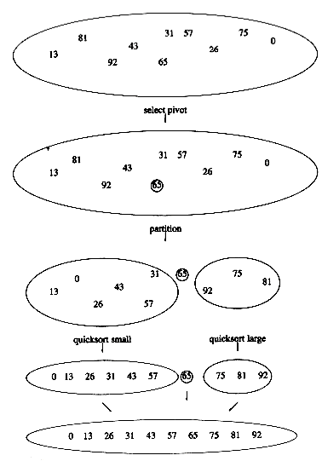
Quick Sort –
Selecting
the Pivot

Slide 72
Quick Sort – Selecting the Pivot
1- The popular, uninformed choice:
Use the first element as the pivot
  This is acceptable if the input is random
  But, if the input is presorted or in reverse order, then the pivot provides a poor partition, because virtually all the elements go into S₁ or S₂
  It happens consistently throughout the recursive calls
➔ Quicksort will take quadratic time to do essentially nothing at all, which is quite embarrassing
2- A Safe Maneuver
A safe course is merely to choose the pivot randomly
  This strategy is generally perfectly safe, unless the random number generator has a flaw
However, random number generation is generally an expensive commodity and does not reduce the average running time of the rest of the algorithm at all

Slide 73
Quick Sort – Selecting the Pivot
The best choice of pivot would be the median of the file.
  The median of a group of n numbers is the (n/2)-th largest number
  Unfortunately, this is hard to calculate and would slow down quicksort considerably
A good estimate can be obtained by picking three elements randomly and using the median of these three as pivot.
  The randomness turns out not to help much
So, the common course is to use as pivot the median of the left, right and center elements
A = {8, 1, 4, 9, 6, 3, 5, 2, 7, 0}
center = A[left + right)/2]
= A [(0+9)/2] = A[4] = 6
pivot: v= median(8, 6, 0) = 6

Slide 74
QuickSort :Partitioning strategy
Example
8 ⁽⁰⁾ | 1 ⁽¹⁾ | 4 ⁽²⁾ | 9 ⁽³⁾ | 6 ⁽⁴⁾ | 3 ⁽⁵⁾ | 5 ⁽⁶⁾ | 2 ⁽⁷⁾ | 7 ⁽⁸⁾ | 0 ⁽⁹⁾
i
pivot
j
The basic algorithm
While i is to the left of j,
  we move i right, skipping over elements smaller than the pivot
  We move j left, skipping over elements larger than the pivot
When i and j have stopped,
  i is pointing at a large element, and
  j is pointing at a small element
If i is to the left of j,
  those elements are swapped
The effect is to push a large element to the right and a small element to the left.
In the example above, i would not move and j would slide over one place

Slide 75
QuickSort :Partitioning strategy
Step 1
8 ⁽⁰⁾ | 1 ⁽¹⁾ | 4 ⁽²⁾ | 9 ⁽³⁾ | 6 ⁽⁴⁾ | 3 ⁽⁵⁾ | 5 ⁽⁶⁾ | 2 ⁽⁷⁾ | 7 ⁽⁸⁾ | 0 ⁽⁹⁾
i
j
pivot

Slide 76
QuickSort :Partitioning strategy
Step 1
8 ⁽⁰⁾ | 1 ⁽¹⁾ | 4 ⁽²⁾ | 9 ⁽³⁾ | 0 ⁽⁴⁾ | 3 ⁽⁵⁾ | 5 ⁽⁶⁾ | 2 ⁽⁷⁾ | 7 ⁽⁸⁾ | 6 ⁽⁹⁾
i
j
pivot
Start by swapping the pivot with the right, starting j at right -1
A[i] = 8 > pivot
  Stop i right over here

Slide 77
QuickSort :Partitioning strategy
Step 1
8 ⁽⁰⁾ | 1 ⁽¹⁾ | 4 ⁽²⁾ | 9 ⁽³⁾ | 0 ⁽⁴⁾ | 3 ⁽⁵⁾ | 5 ⁽⁶⁾ | 2 ⁽⁷⁾ | 7 ⁽⁸⁾ | 6 ⁽⁹⁾
i
j
j
pivot
A[j] = 7 > pivot
  Move Left
A[j] = 2 < pivot
  Stop j right over here
Swap A[i] and A[j]

Slide 78
QuickSort :Partitioning strategy
Step 1
2 ⁽⁰⁾ | 1 ⁽¹⁾ | 4 ⁽²⁾ | 9 ⁽³⁾ | 0 ⁽⁴⁾ | 3 ⁽⁵⁾ | 5 ⁽⁶⁾ | 8 ⁽⁷⁾ | 7 ⁽⁸⁾ | 6 ⁽⁹⁾
i
j
pivot
A[j] = 7 > pivot
  Move Right
A[j] = 2 < pivot
  Stop j right over here
Swap A[i] and A[j]

Slide 79
QuickSort :Partitioning strategy
Step 2
2 ⁽⁰⁾ | 1 ⁽¹⁾ | 4 ⁽²⁾ | 9 ⁽³⁾ | 0 ⁽⁴⁾ | 3 ⁽⁵⁾ | 5 ⁽⁶⁾ | 8 ⁽⁷⁾ | 7 ⁽⁸⁾ | 6 ⁽⁹⁾
i
i
i
i
j
j
pivot
A[i] = 2 < pivot
  Move Right
A[i] = 1 < pivot
  Move Right
A[i] = 4 < pivot
  Move Right
A[i] = 9 > pivot
  Stop i right over here
A[j] = 8 > pivot
  Move Left
A[j] = 5 < pivot
  Stop j right over here

Slide 80
QuickSort :Partitioning strategy
Step 2
2 ⁽⁰⁾ | 1 ⁽¹⁾ | 4 ⁽²⁾ | 5 ⁽³⁾ | 0 ⁽⁴⁾ | 3 ⁽⁵⁾ | 9 ⁽⁶⁾ | 8 ⁽⁷⁾ | 7 ⁽⁸⁾ | 6 ⁽⁹⁾
i
j
pivot
A[i] = 2 < pivot
  Move Right
A[i] = 1 < pivot
  Move Right
A[i] = 4 < pivot
  Move Right
A[i] = 9 > pivot
  Stop i right over here
A[j] = 8 > pivot
  Move Left
A[j] = 5 < pivot
  Stop j right over here
Swap A[i] and A[j]

Slide 81
QuickSort :Partitioning strategy
Step 3
2 ⁽⁰⁾ | 1 ⁽¹⁾ | 4 ⁽²⁾ | 5 ⁽³⁾ | 0 ⁽⁴⁾ | 3 ⁽⁵⁾ | 9 ⁽⁶⁾ | 8 ⁽⁷⁾ | 7 ⁽⁸⁾ | 6 ⁽⁹⁾
i
i
i
j
i
pivot
A[i] = 5 < pivot
  Move Right
A[i] = 0 < pivot
  Move Right
A[i] = 3 < pivot
  Move Right
A[i] = 9 > pivot
  Stop i right over here

Slide 82
QuickSort :Partitioning strategy
Step 3
2 ⁽⁰⁾ | 1 ⁽¹⁾ | 4 ⁽²⁾ | 5 ⁽³⁾ | 0 ⁽⁴⁾ | 3 ⁽⁵⁾ | 9 ⁽⁶⁾ | 8 ⁽⁷⁾ | 7 ⁽⁸⁾ | 6 ⁽⁹⁾
j
j
i
pivot
A[i] = 5 < pivot
  Move Right
A[i] = 0 < pivot
  Move Right
A[i] = 3 < pivot
  Move Right
A[i] = 9 > pivot
  Stop i right over here
A[j] = 9 > pivot
  Move Left
A[j] = 3 < pivot
  Stop j right over here
i and j have crossed
  So no swap for A[i] and A[j]
Instead Swap A[i] and A[pivot]

Slide 83
QuickSort :Partitioning strategy
Step 3
2 ⁽⁰⁾ | 1 ⁽¹⁾ | 4 ⁽²⁾ | 5 ⁽³⁾ | 0 ⁽⁴⁾ | 3 ⁽⁵⁾ | 6 ⁽⁶⁾ | 8 ⁽⁷⁾ | 7 ⁽⁸⁾ | 9 ⁽⁹⁾
j
i
pivot
A[i] = 5 < pivot
  Move Right
A[i] = 0 < pivot
  Move Right
A[i] = 3 < pivot
  Move Right
A[i] = 9 > pivot
  Stop i right over here
A[j] = 9 > pivot
  Move Left
A[j] = 3 < pivot
  Stop j right over here
i and j have crossed
  So no swap for A[i] and A[j]
Instead Swap A[i] and A[pivot]

Slide 84
QuickSort : Recursive calls
2 ⁽⁰⁾ | 1 ⁽¹⁾ | 4 ⁽²⁾ | 5 ⁽³⁾ | 0 ⁽⁴⁾ | 3 ⁽⁵⁾ | 6 ⁽⁶⁾ | 8 ⁽⁷⁾ | 7 ⁽⁸⁾ | 9 ⁽⁹⁾
pivot
2 ⁽⁰⁾ | 1 ⁽¹⁾ | 4 ⁽²⁾ | 5 ⁽³⁾ | 0 ⁽⁴⁾ | 3 ⁽⁵⁾ | 6 ⁽⁶⁾ | 8 ⁽⁷⁾ | 7 ⁽⁸⁾ | 9 ⁽⁹⁾
i
0
i -1
i + 1
N -1

Slide 85
QuickSort : Left Recursive call
2 ⁽⁰⁾ | 1 ⁽¹⁾ | 4 ⁽²⁾ | 5 ⁽³⁾ | 0 ⁽⁴⁾ | 3 ⁽⁵⁾

Slide 86
QuickSort : Left Recursive call
Pivot Selection
2 ⁽⁰⁾ | 1 ⁽¹⁾ | 4 ⁽²⁾ | 5 ⁽³⁾ | 0 ⁽⁴⁾ | 3 ⁽⁵⁾
2 ⁽⁰⁾ | 1 ⁽¹⁾ | 3 ⁽²⁾ | 5 ⁽³⁾ | 0 ⁽⁴⁾ | 4 ⁽⁵⁾
2 > 4
2 > 3
4 > 3

Slide 87
QuickSort : Left Recursive call
Pivot Swap out
2 ⁽⁰⁾ | 1 ⁽¹⁾ | 4 ⁽²⁾ | 5 ⁽³⁾ | 0 ⁽⁴⁾ | 3 ⁽⁵⁾
i
j
pivot

Slide 88
QuickSort : Left Recursive call
Movements
2 ⁽⁰⁾ | 1 ⁽¹⁾ | 4 ⁽²⁾ | 5 ⁽³⁾ | 0 ⁽⁴⁾ | 3 ⁽⁵⁾
i
j
pivot

Slide 89
QuickSort : Left Recursive call
Swap
2 ⁽⁰⁾ | 1 ⁽¹⁾ | 4 ⁽²⁾ | 5 ⁽³⁾ | 0 ⁽⁴⁾ | 3 ⁽⁵⁾
i
j
pivot

Slide 90
QuickSort : Left Recursive call
Step 1: Swap
2 ⁽⁰⁾ | 1 ⁽¹⁾ | 0 ⁽²⁾ | 5 ⁽³⁾ | 4⁽⁴⁾ | 3 ⁽⁵⁾
i
j
pivot

Slide 91
QuickSort : Left Recursive call
Movements
2 ⁽⁰⁾ | 1 ⁽¹⁾ | 0 ⁽²⁾ | 5 ⁽³⁾ | 4⁽⁴⁾ | 3 ⁽⁵⁾
i
j
pivot
i & j crossed

Slide 92
QuickSort : Left Recursive call
Swap with the pivot
2 ⁽⁰⁾ | 1 ⁽¹⁾ | 0 ⁽²⁾ | 5 ⁽³⁾ | 4⁽⁴⁾ | 3 ⁽⁵⁾
i
pivot

Slide 93
QuickSort : Left Recursive call
Swap with the pivot
2 ⁽⁰⁾ | 1 ⁽¹⁾ | 0 ⁽²⁾ | 3 ⁽³⁾ | 4⁽⁴⁾ | 5 ⁽⁵⁾
i
pivot

Slide 94
QuickSort :Recursive Calls
2 ⁽⁰⁾ | 1 ⁽¹⁾ | 0 ⁽²⁾ | 3 ⁽³⁾ | 4⁽⁴⁾ | 5 ⁽⁵⁾
i
pivot
pivot
2 ⁽⁰⁾ | 1 ⁽¹⁾ | 0 ⁽²⁾ | 3 ⁽³⁾ | 4⁽⁴⁾ | 5 ⁽⁵⁾
i
0
i -1
i + 1
Right

Slide 95
QuickSort
void quick_sort( input_type a[ ], unsigned int n )
{
q_sort( a, 0, n-1 );
}

Slide 96
QuickSort: Core Function
void q_sort( input_type a[], int left, int right )
{
int i, j; int pivot;
if( left + CUTOFF <= right )
{
pivot = median3( a, left, right );
i = left; j = right - 1;
for ( ; ; )
{
  while( a[++i] < pivot );
  while( a[--j] > pivot );
  if( i < j )
  swap( &a[i], &a[j] );
  else
  break;
  } //end for loop
swap( &a[i], &a[right-1] ); /*restore pivot*/
q_sort( a, left, i -1 ); // left recursive call
q_sort( a, i +1, right ); // lright recursive call
}
}

Slide 97
QuickSort: Medians
/* Return median of left, center, and right. */
/* Order these and hide pivot */
int median3( input_type a[], int left, int right )
{
int center;
center = (left + right) / 2;
if ( a[left] > a[center] )
swap( &a[left], &a[center] );
if ( a[left] > a[right] )
swap( &a[left], &a[right] );
if ( a[center] > a[right] )
swap( &a[center], &a[right] );
/* a[left] <= a[center] <= a[right] */
swap( &a[center], &a[right-1] );
return a[right-1]; /* return pivot */
}

Slide 98
QuickSort: Medians
/* Return median of left, center, and right. */
/* Order these and hide pivot */
int median3( input_type a[], int left, int right )
{
int center;
center = (left + right) / 2;
if ( a[left] > a[center] )
swap( &a[left], &a[center] );
if ( a[left] > a[right] )
swap( &a[left], &a[right] );
if ( a[center] > a[right] )
swap( &a[center], &a[right] );
/* a[left] <= a[center] <= a[right] */
swap( &a[center], &a[right-1] );
return a[right-1]; /* return pivot */
}
8 ⁽⁰⁾ | 1 ⁽¹⁾ | 4 ⁽²⁾ | 9 ⁽³⁾ | 6 ⁽⁴⁾ | 3 ⁽⁵⁾ | 5 ⁽⁶⁾ | 2 ⁽⁷⁾ | 7 ⁽⁸⁾ | 0 ⁽⁹⁾
8 ⁽⁰⁾
6 ⁽⁴⁾
0 ⁽⁹⁾
left
center
right
8 > 6
6 > 0
8 > 6

Slide 99
QuickSort: Medians
/* Return median of left, center, and right. */
/* Order these and hide pivot */
int median3( input_type a[], int left, int right )
{
int center;
center = (left + right) / 2;
if ( a[left] > a[center] )
swap( &a[left], &a[center] );
if ( a[left] > a[right] )
swap( &a[left], &a[right] );
if ( a[center] > a[right] )
swap( &a[center], &a[right] );
/* a[left] <= a[center] <= a[right] */
swap( &a[center], &a[right-1] );
return a[right-1];
}
8 ⁽⁰⁾ | 1 ⁽¹⁾ | 4 ⁽²⁾ | 9 ⁽³⁾ | 6 ⁽⁴⁾ | 3 ⁽⁵⁾ | 5 ⁽⁶⁾ | 2 ⁽⁷⁾ | 7 ⁽⁸⁾ | 0 ⁽⁹⁾
0 ⁽⁰⁾
6 ⁽⁴⁾
6 ⁽⁴⁾
7 ⁽⁸⁾
8 ⁽⁹⁾
center
right -1
8 > 6
pivot
6 > 0
8 > 6
/* hide pivot */
/* return pivot */

Slide 100
QuickSort: Core Function
void q_sort( input_type a[], int left, int right )
{
int i, j; int pivot;
if( left + CUTOFF <= right )
{
pivot = median3( a, left, right );
i=left; j=right-1;
for ( ; ; )
{
  while ( a[++i] < pivot );
  while ( a[--j] > pivot );
  if ( i < j )
  swap( &a[i], &a[j] );
  else
  break;
  } //end for loop
swap( &a[i], &a[right-1] );
q_sort( a, left, i-1 );
q_sort( a, i+1, right );
}
}
8 ⁽⁰⁾ | 1 ⁽¹⁾ | 4 ⁽²⁾ | 9 ⁽³⁾ | 7 ⁽⁴⁾ | 3 ⁽⁵⁾ | 5 ⁽⁶⁾ | 2 ⁽⁷⁾ | 6 ⁽⁸⁾ | 0 ⁽⁹⁾
0 ⁽⁰⁾
6 ⁽⁴⁾
7 ⁽⁴⁾
6 ⁽⁸⁾
8 ⁽⁹⁾
i = left
center
j = right -1
pivot
/* while i is to the left of j,
  move i right, skipping over elements smaller than the pivot
  move j left, skipping over elements larger than the pivot. */
/* If i is to the left of j,
  those elements are swapped */

Slide 101
QuickSort: Core Function
void q_sort( input_type a[], int left, int right )
{
int i, j; int pivot;
if( left + CUTOFF <= right )
{
pivot = median3( a, left, right );
i=left; j=right-1;
for ( ; ; )
{
  while ( a[++i] < pivot );
  while ( a[--j] > pivot );
  if ( i < j )
  swap( &a[i], &a[j] );
  else
  break;
  } //end for loop
swap( &a[i], &a[right-1] );
q_sort( a, left, i-1 );
q_sort( a, i+1, right );
}
}
8 ⁽⁰⁾ | 1 ⁽¹⁾ | 4 ⁽²⁾ | 2 ⁽³⁾ | 5 ⁽⁴⁾ | 3 ⁽⁵⁾ | 7 ⁽⁶⁾ | 9 ⁽⁷⁾ | 6 ⁽⁸⁾ | 0 ⁽⁹⁾
0 ⁽⁰⁾
7 ⁽⁴⁾
6 ⁽⁸⁾
8 ⁽⁹⁾
left
j
i
right
right -1
pivot
/* loop terminated when ( i > j ) i.e., i and j have crossed → so no swap is performed */
/*restore pivot*/
// left recursive call
// lright recursive call

Slide 102
Linear Order Sorting Algorithms
Counting Sort
Radix Sort

